Slide 1


Fundamentals of RM
RM System and Process
Leadership in RM
Incident Investigation
RM Tools & Challenges
RM in Industry
People & Org.
Application and Perspectives
On Becoming a
Leader in Risk Management
ENGG404 - Lecture
Chapter 6.9: Professionalism, and Applications of Incident Investigation and Professional Engineer’s Responsibilities

Slide 2
Learning Outcomes
Apply key concepts, principles, and practices of risk management in analyzing a loss incident, identifying what went wrong, and determining an appropriate course of action.
This lecture is an opportunity to apply – put into practice – some of the principles, practices, and knowledge that we have been learning the past few lectures. Specifically:
  Case 8 MMA Lac Megantic LI, some facts
  Chapter 6.3: OH&S Regulatory Framework, Engineering under Alberta OH&S Code, Part 3 Specifications and Certifications, Section 12 Following specifications
  Chapter 6.9: Professionalism, Ethics and Equity, Integrity, Conflict of Interest – Your Professional Responsibilities
Chapter 6.9: Professionalism, Applications, and Professional Responsibilities
2
Notes:
2

Slide 3
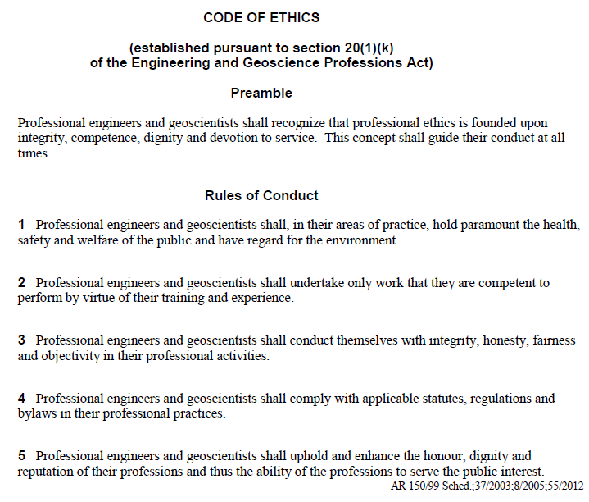
APEGA Code of Ethics (Rules of Conduct) – An Excerpt:
Engineering
Flixborough
Ethics
Discuss
APEGA & OHS
Chapter 6.9: Professionalism, Ethics and Equity
3
Notes:
3

Slide 4
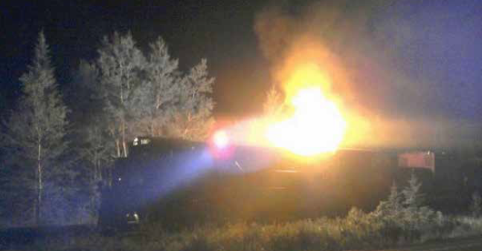
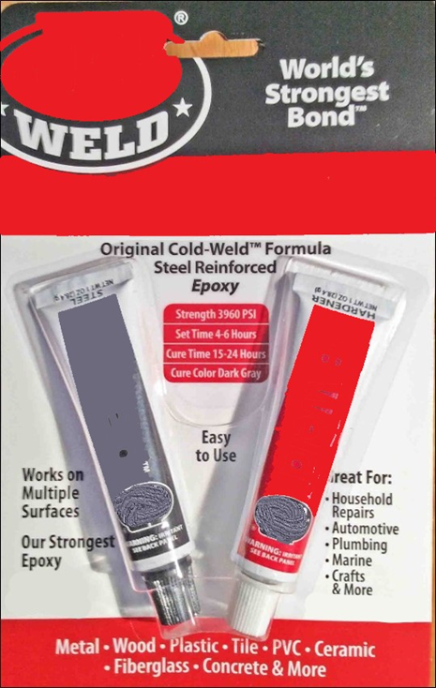
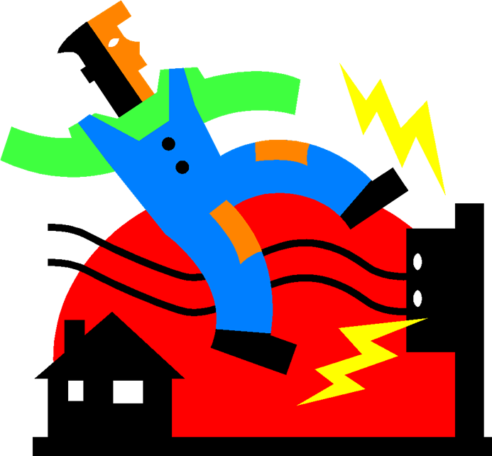
Case 8 Lac-Mégantic / MMA Train Disaster – Some Facts
In October 2012, eight months before this incident, the lead locomotive was sent to MMA’s repair shop following an engine failure.
Given the significant time and cost of a standard repair, and the pressure to return the locomotive to service (RTS), the engine was repaired with an epoxy-metal-like material that lacked the required strength and durability i.e. a temporary repair.
This material failed in service, (8 months later) leading to engine surges and excessive black and white smoke.
Eventually, oil began to accumulate in the body of the turbocharger, where it overheated and caught fire on the night of the incident.
This is the equivalent of Process Safety LI in MechE. … the “triggering event”
Chapter 6.9: Professionalism, Applications, and Professional Responsibilities
4
Notes:
4

Slide 5
Chapter 6.3: OH&S Regulatory Framework in Canada, Engineering under Alberta OH&S Code:
Specific responsibilities for professional engineers:
Part 3 Specifications and Certifications
12 Following specifications:
An employer must ensure that
(a) … (b) … (c) …
(d) equipment and supplies are erected, installed, assembled, started, operated, handled, stored, serviced, tested, adjusted, calibrated, maintained, repaired, and dismantled in accordance
with the manufacturer’s specifications
or the specifications certified by a professional engineer.
Chapter 6.9: Professionalism, Applications, and Professional Responsibilities
5
Notes:
5

Slide 6
Examine - Professionalism and Application:
As a professional engineer, your responsibilities can be complex.
Concerning the MMA RR locomotive, was the engine repaired in accordance with manufacturer’s specifications? i.e. What would the OEM (original equipment manufacturer) recommend?
  An OEM would recommend repair using a new engine part.
  So, no, the repair was more than likely NOT repaired in accordance with manufacturer’s specifications.
  Suppose you are an Investigator with OH&S: in light of the AB OH&S Code Section 12 Following Specifications, what question would you ask?
  “Was the engine repaired in accordance with manufacturer’s specifications? Or spec’ns certified by a professional engineer?”
  “Or repaired in accordance with specifications certified by a professional engineer?”
Chapter 6.9: Professionalism, Applications, and Professional Responsibilities
6
Notes:
6

Slide 7
Examine - Professionalism and Application:
As a professional engineer, your responsibilities can be complex.
Concerning the MMA RR locomotive, was the engine repaired in accordance with manufacturer’s specifications? i.e. What would the OEM (original equipment manufacturer) recommend?
  An OEM would recommend repair using a new engine part.
  So, no, the repair was more than likely NOT repaired in accordance with manufacturer’s specifications.
  Suppose you are an Investigator with OH&S: in light of the AB OH&S Code Section 12 Following Specifications, what question would you ask?
  “Was the engine repaired in accordance with manufacturer’s specifications? Or spec’ns certified by a professional engineer?”
  “Or repaired in accordance with specifications certified by a professional engineer?”
  The scope and role of the regulator is to investigate to determine if an organization has contravened a statutory regulation only, NOT to drill deeper into the latent causes of a loss incident.
  Contrast this with the role of business – as modelled in the Team Project (investigate to latent causes, etc.)
Chapter 6.9: Professionalism, Applications, and Professional Responsibilities
7
Notes:
7

Slide 8
ALE #1: Examine Professionalism and Application:
Please confer (pen-to-paper): As a professional engineer, your responsibilities can be complex. Now suppose you are the professional engineer responsible for the locomotive maintenance and repair program (well prior to the MMA LI).
  What choices do you have to repair the locomotive? (MM-Poll)
  Delay RTS, wait for the OEM part, and install the OEM part.
  Rationale: a temporary repair is unacceptable.
  Design & certify a temporary repair using two-part metal-epoxy, and specify that the temporary repair has a specific limited life-time of operation. (Is it 1 hour, 100 hours, 1000 hours? What will the subject-matter expert specify?)
  Blindly approve “rubber-stamp” the design for a temporary repair.
  Do nothing – ignore the mechanic’s repair work using two-part metal-epoxy – and believe that you cannot be held responsible because the work is not under your responsibility / not approved / not authorized / not certified by you / not.
  What is an acceptable path to repair the locomotive? (MM-Poll)
Chapter 6.9: Professionalism, Applications, and Professional Responsibilities
8
Notes:
8

Slide 9
ALE #1: Examine Professionalism and Application:
Please confer (pen-to-paper): As a professional engineer, your responsibilities can be complex. Now suppose you are the professional engineer responsible for the locomotive maintenance and repair program (well prior to the MMA LI).
  What choices do you have to repair the locomotive? (MM-Poll)
  Delay RTS, wait for the OEM part, and install the OEM part.
  Rationale: a temporary repair is unacceptable.
  Design & certify a temporary repair using two-part metal-epoxy, and specify that the temporary repair has a specific limited life-time of operation. (Is it 1 hour, 100 hours, 1000 hours? What will the subject-matter expert specify?)
  Blindly approve “rubber-stamp” the design for a temporary repair.
  Do nothing – ignore the mechanic’s repair work using two-part metal-epoxy – and believe that you cannot be held responsible because the work is not under your responsibility / not approved / not authorized / not certified by you / not.
  What is an acceptable path to repair the locomotive? (MM-Poll)
Chapter 6.9: Professionalism, Applications, and Professional Responsibilities
9
Notes:
9

Slide 10
Example: Examine Professionalism and Application:
As a professional engineer, your responsibilities can be complex. Now suppose you are the professional engineer responsible for the locomotive maintenance and repair program (well prior to the MMA LI).
  What choices do you have to repair the locomotive?
  Delay RTS, wait for the OEM part, and install the OEM part.
  Rationale: a temporary repair is unacceptable.
  Design & certify a temporary repair using two-part metal-epoxy, and specify that the temporary repair has a specific limited life-time of operation. (Is it 1 hour, 100 hours, 1000 hours? What will the subject-matter expert specify?)
  Blindly approve “rubber-stamp” the design for a temporary repair.
  Do nothing – ignore the mechanic’s repair work using two-part metal-epoxy – and believe that you cannot be held responsible because the work is not under your responsibility / not approved / not authorized / not certified by you / not.
  What is an acceptable path to repair the locomotive?
  Choice 1) or 2) are the only two acceptable choices!
Chapter 6.9: Professionalism, Applications, and Professional Responsibilities
10
Notes:
10

Slide 11
What About When We Are NOT Professional?
  Engineering and Geoscience Professions Act, RSA 2000, Chapter E-11:
  Determination of unprofessional conduct and unskilled practice
  44(1) Any conduct of a professional member, licensee, permit holder, certificate holder or member-in-training that in the opinion of the Discipline Committee or the Appeal Board
  (a) is detrimental to the best interests of the public,
  (b) contravenes a code of ethics of the profession as established under the regulations,
  (c) harms or tends to harm the standing of the profession generally,
  (d) displays a lack of knowledge of or lack of skill or judgment in the practice of the profession, or
  (e) displays a lack of knowledge of or lack of skill or judgment in the carrying out of any duty or obligation undertaken in the practice of the profession,
  constitutes either unskilled practice of the profession or unprofessional conduct,
Chapter 6.9: Professionalism, Applications, and Professional Responsibilities
11
Notes:
11

Slide 12
What About When We Are NOT Professional?
  “Unprofessional Conduct” and “Unskilled Practice Of Engineering”
  As a professional engineer, we strive for professionalism which includes “professional conduct” and “skilled practice of engineering”.
  We fail as engineers with either or both “unprofessional conduct” and “unskilled practice of engineering”
  “Unprofessional conduct” can be very loosely termed as:
  “I am doing something I ought not to do”, or
  “I am not doing something I ought to do”.
  For our purposes here, this predominantly applies to our code of ethics and legal requirements.
  “Unskilled practice of engineering” can be loosely termed relative to an applied science as:
  “I don’t know what I am doing”, or
  “I ought to have known the requirements”, or
  “I did not do what I ought to have known to do”, or
  “I did what I ought to have known not to do”.
  For our purposes here, this predominantly applies to the application of any science, technology, or engineering
Chapter 6.9: Professionalism, Applications, and Professional Responsibilities
12
Notes:
12

Slide 13
ALE #3: What About When We Are NOT Professional?
  Please confer on these scenarios for “Unprofessional Conduct” and “Unskilled Practice Of Engineering” (MM-Poll):
  Recall these choices for repairing the locomotive:
  Delay RTS, wait for the OEM part, and install the OEM part.
  Rationale: a temporary repair is unacceptable.
  Design & certify a temporary repair using two-part metal-epoxy, and specify that the temporary repair has a specific limited life-time of operation, and the repair is successful for the specified duration i.e. no failure and no incident.
  Design & certify a temporary repair using two-part metal-epoxy, and specify that the temporary repair has a specific limited life-time of operation, and the repair fails while in temporary service i.e. incident AND APEGA investigates.
  Blindly approve “rubber-stamp” the design for a temporary repair.
  Do nothing – ignore the mechanic’s repair work using two-part metal-epoxy – and believe that you cannot be held responsible because the work is not under your responsibility / not approved / not authorized / not certified by you / not.
  Which of these is: unprofessional conduct, or unskilled practice, or neither, or both, or “not enough information”?
Chapter 6.9: Professionalism, Applications, and Professional Responsibilities
13
Notes:
13

Slide 14
Example: What About When We Are NOT Professional?
  Certain scenarios and our decisions can reflect either “Unprofessional Conduct” or “Unskilled Practice Of Engineering” or both! So, let’s have a preliminary examination of “Unprofessional Conduct” and “Unskilled Practice Of Engineering” for the five scenarios:
  Delay RTS, wait for the OEM part, and install the OEM part. (No incident)
  Both professional conduct (complied with the regulations, specifically OH&S Code Section 12) and skilled practice (knew what to do)!
  Design & certify a temporary repair using two-part metal-epoxy, and the repair is successful. (No incident)
  Both professional conduct (complied with the regulations) and skilled practice (knew what to do)!
  Design & certify a temporary repair using two-part metal-epoxy, and the repair fails while in temporary service i.e. incident AND the Statutory Board (APEGA members) investigates.
  Professional conduct (complied with the reg’s) but perhaps unskilled practice i.e. maybe did not know what to do e.g. over-estimated strength of epoxy?
  Documentation of risk management activities (e.g. design calculations, etc.) i.e. due diligence, will certainly play a part in the ruling / judgment re: skilled practice or unskilled practice i.e. not enough information.
  (Continued on next slide)
Chapter 6.9: Professionalism, Applications, and Professional Responsibilities
14
Notes:
14

Slide 15
Example: What About When We Are NOT Professional?
  Certain scenarios and our decisions can reflect either “Unprofessional Conduct” or “Unskilled Practice Of Engineering” or both! So, let’s have a preliminary examination of “Unprofessional Conduct” and “Unskilled Practice Of Engineering” for the five scenarios:
  Blindly approve “rubber-stamp” the design for a temporary repair.
  Unprofessional conduct: even though the repair was “certified” to meet the “letter” of the law, it did not meet the “intent” of the law; it centres back to Code of Conduct “Professional engineers shall comply with the regulations”
  Unskilled practice: the engineer ought to have known that: a) Part 3 Section 12 of the OH&S Code applied, and/or b) a temporary repair of this nature was not sufficiently durable for its application.
  Do nothing – ignore the mechanic’s repair work using two-part metal-epoxy – and believe that you cannot be held responsible because the work is not under your responsibility / not approved / not authorized / not certified by you / not.
  Unprofessional conduct: the engineer ought to have known to meet the intent of the law, and protect the interests of the public.
  Unskilled practice: the engineer ought to have known that: a) Part 3 Section 12 of the OH&S Code applied, and/or b) a temporary repair of this nature was not sufficiently durable for its application i.e. equivalent to an OEM-approved replacement part.
Chapter 6.9: Professionalism, Applications, and Professional Responsibilities
15
Notes:
15

Slide 16
Example: What About When We Are NOT Professional?
  It is important to note that this is a simplistic and brief examination of these scenarios. Such scenarios, when investigated by statutory boards of our peers appointed under the EGP Act (Investigative Committee, Discipline Committee) are very complex and require a detailed investigation and examination to reach an equitable decision.
  So, in each of scenarios 3), 4), and 5), where might these investigations go?
  More information is required certainly for 3) but may also be necessary for 4) & 5) to reach a definitive and equitable finding as to whether the conduct of the professional engineer was:
  (a) detrimental to the best interests of the public,
  (b) contravened a code of ethics of the profession as established under the regulations,
  (c) harmed or tended to harm the standing of the profession generally,
  (d) displayed a lack of knowledge of or lack of skill or judgment in the practice of the profession, or
  (e) displayed a lack of knowledge of or lack of skill or judgment in the carrying out of any duty or obligation undertaken in the practice of the profession,
Chapter 6.9: Professionalism, Applications, and Professional Responsibilities
16
Notes:
16

Slide 17
Summary and Key Lesson:
Summary:
This topic demonstrates how to apply – put into practice – some of the risk management principles and practices that we have been learning the past few topics, specifically:
  Case 8 MMA Lac Megantic LI, Some Facts
  Chapter 6.3: OH&S Regulatory Framework, Engineering under Alberta OH&S Code, Part 3 Specifications and Certifications, Section 12 Following specifications
  Chapter 6.9: Professionalism, Ethics and Equity, Integrity, Conflict of Interest – Your Professional Responsibilities
Key Lessons:
You may have professional engineering responsibilities that may not be readily apparent, so you need to search for them, learn them, and practice them!
Which ESG applies here? KP#2: Know your program!
We are judged on our professional conduct and our skilled practice in engineering.
Chapter 6.9: Professionalism, Applications, and Professional Responsibilities
17
Notes:
17

Slide 18
Any questions?
Notes:
18

